Slide 1
Countries & Intl Affairs
Torran Kahleck & Xinyu Chen

Slide 2
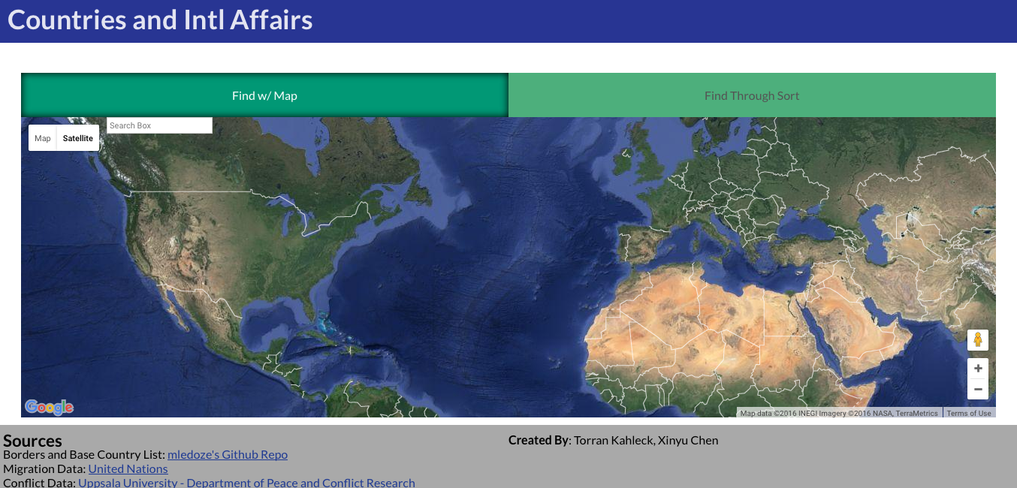
Overview/Finding Country by Map
Database
Migration data
Trade data
Treaty data
Leaders, climate, languages
GDP, CO2, Population, Life Expectancy
Multiple ways to sort and view country data
Front end done with AngularJS
Communicates with database via AJAX calls to PHP scripts
PHP returns JSON encoded objects
Map clicks call Google GeoLocation API to get country name
Name used to request country data

Slide 3
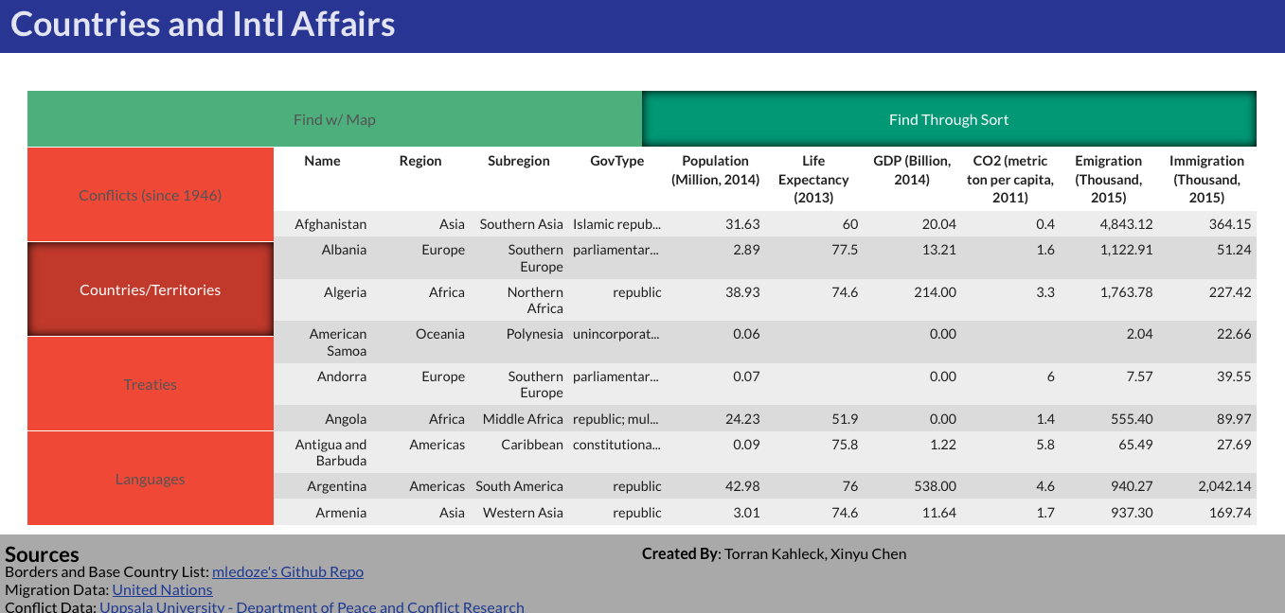
Finding Country by Data

Slide 4
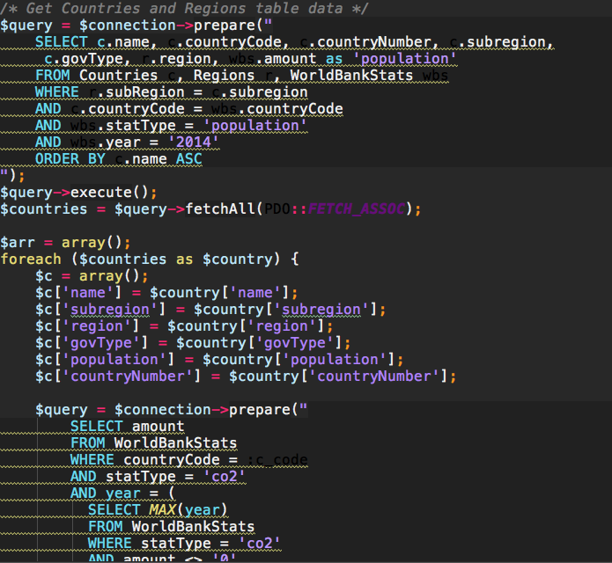
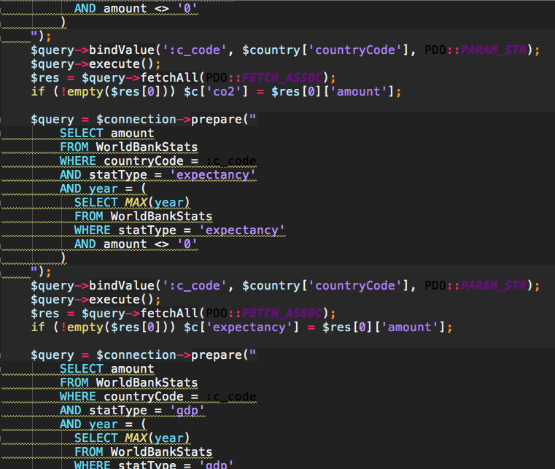
Create Country List

Slide 5
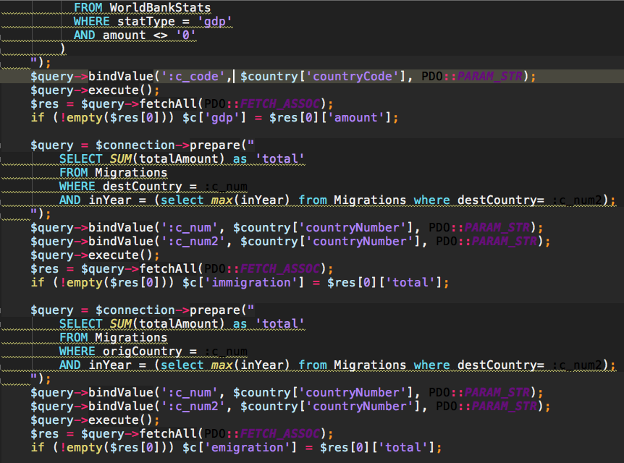
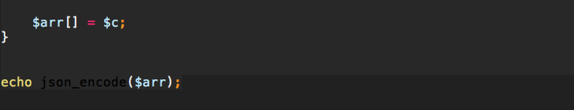
Create Country List cont…
This script is the most time consuming
About 2 seconds locally
Was taking closer to 10 seconds before introducing an index on Migration year data
Clicking country in list will call query to retrieve all data for that country

Slide 6
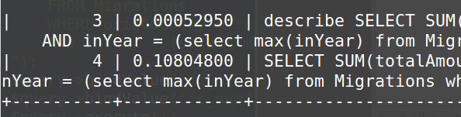
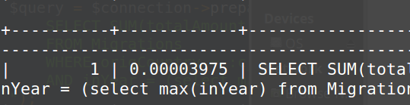
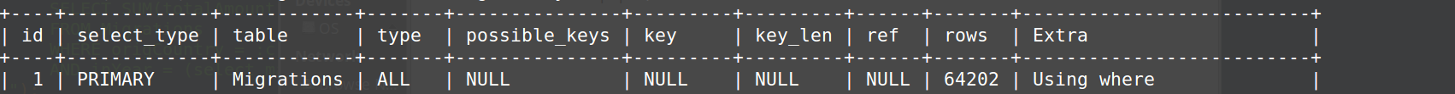
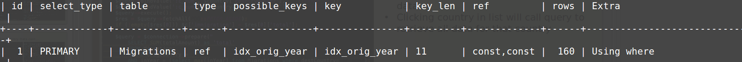
Create Country List cont…
Use index to speed up queries
Query time without index (left) vs with index (right)
Query rows without index (top) vs with index (bottom)
This script is the most time consuming
About 2 seconds locally
Was taking closer to 10 seconds before introducing an index on Migration year data
Clicking country in list will call query to retrieve all data for that country

Slide 7
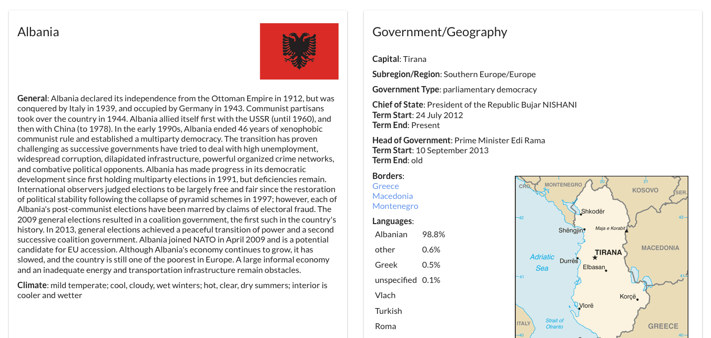
Country Data

Slide 8
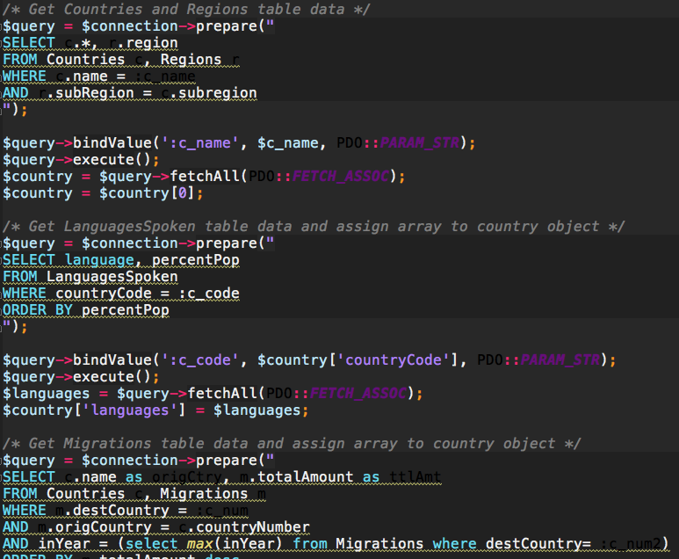
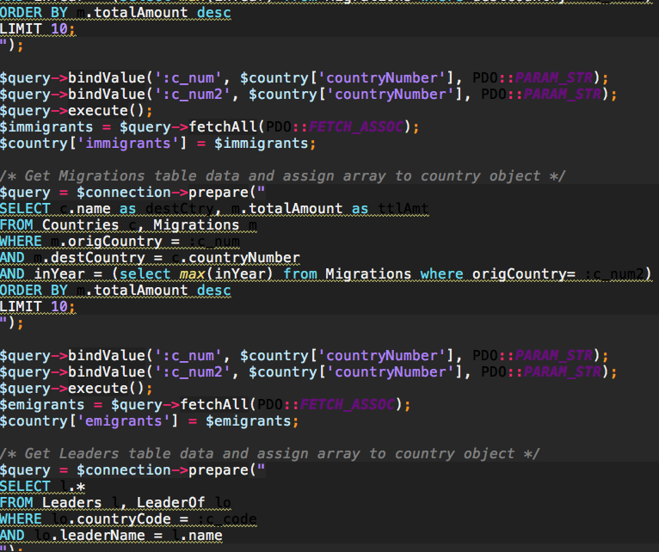
Get Country Data

Slide 9
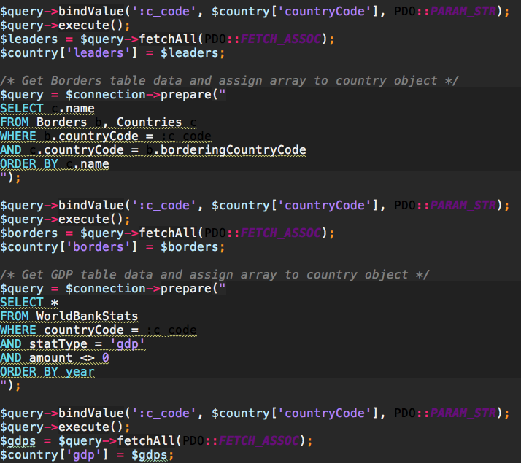
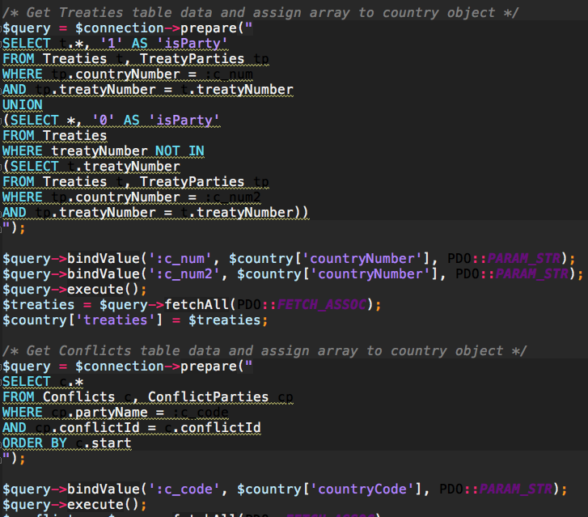
Get Country Data cont…

Slide 10
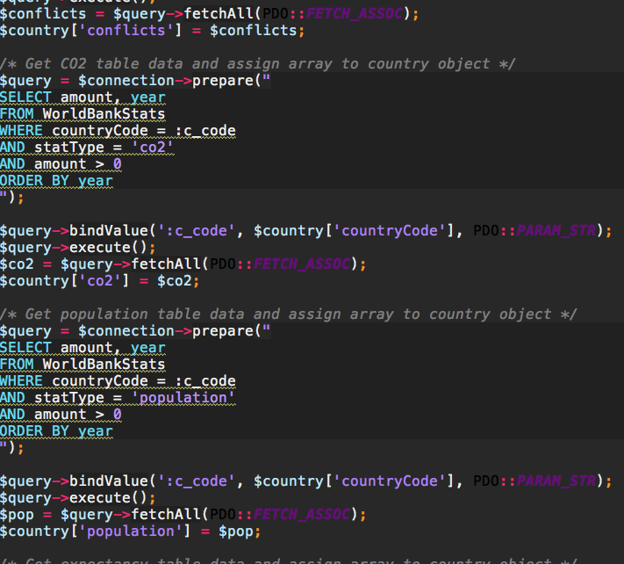
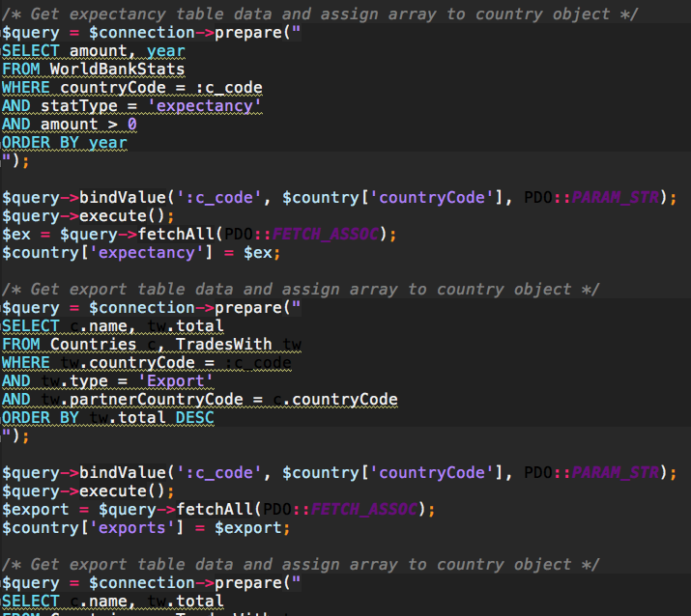
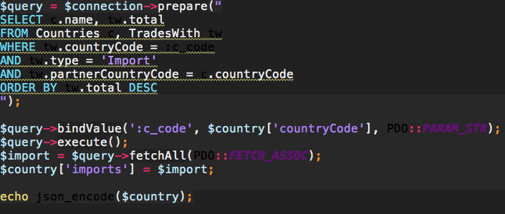
Get Country Data cont…

Slide 11
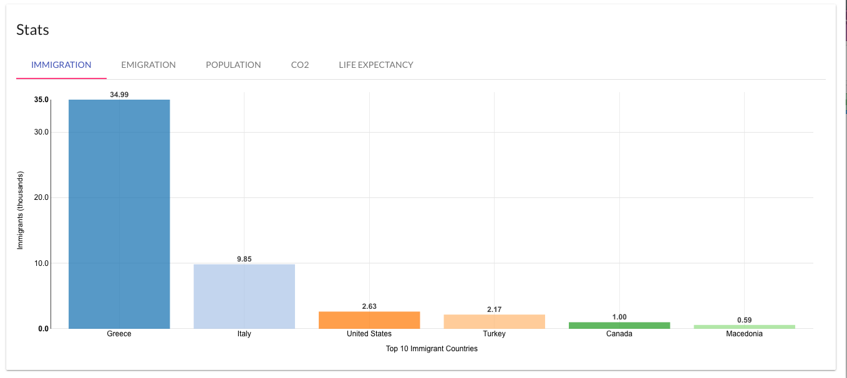
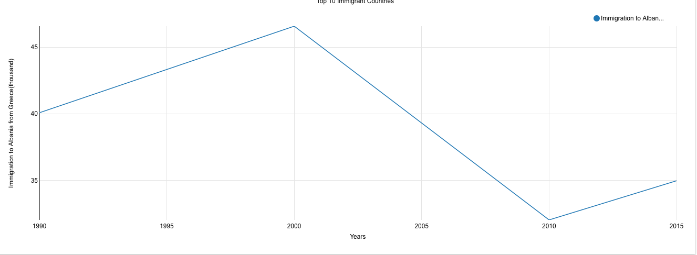
Graph Stats
Migration data presented as bar graphs
Clicking on one of the bars will display a detailed line graph of migration to/from that country over the last couple decades

Slide 12
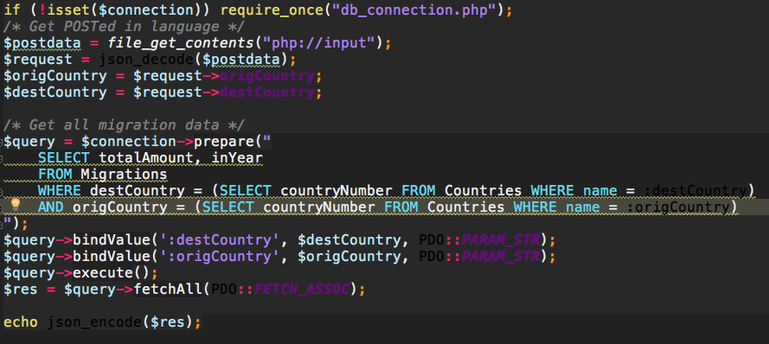
Get Subgraph Stats

Slide 13
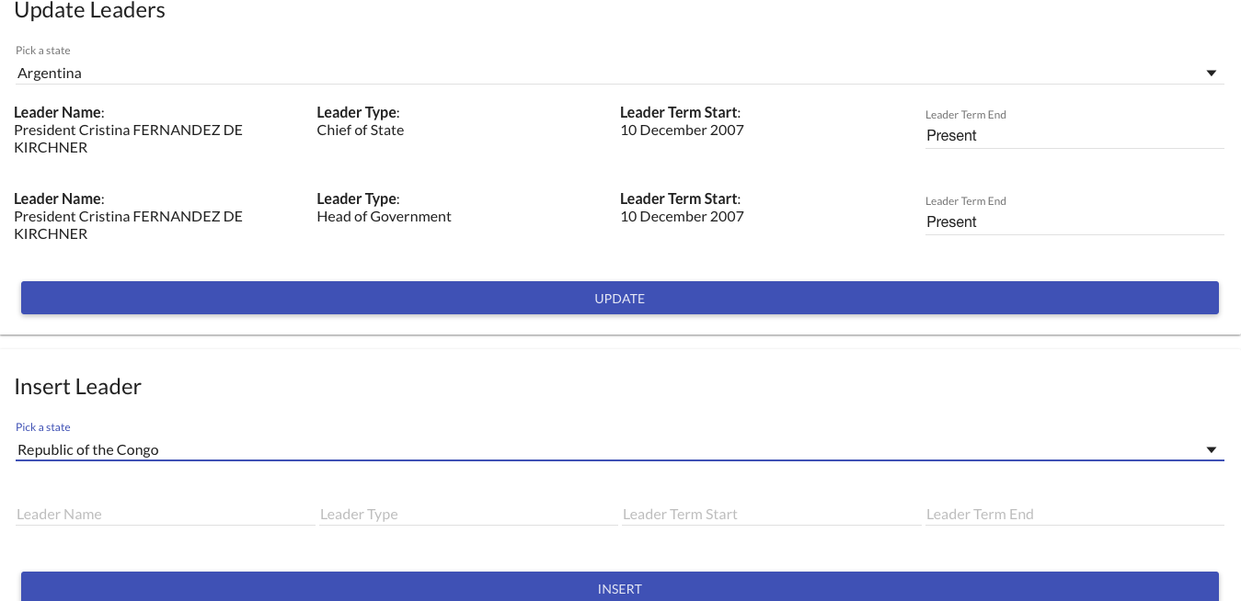
Update/Insert Leaders

Slide 14
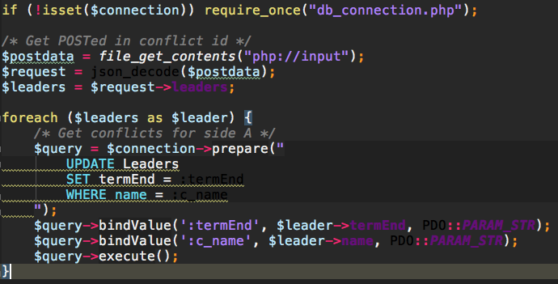
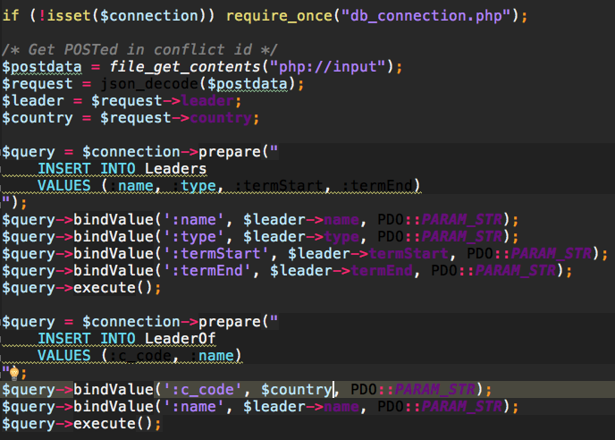
Update/Insert Leaders cont..

Slide 15
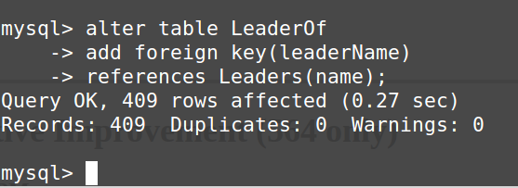
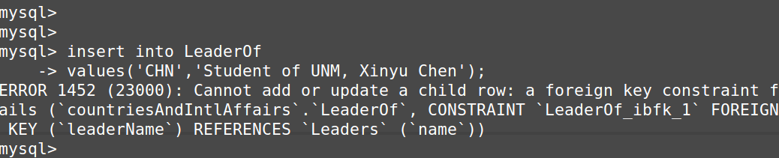
Update/Insert Leaders cont..
Use foreign key to assure integrity
Add references constraint on leader's name (left)
Test add a new LeaderOf tuple that violates reference constraint (below)
Similarly, we have foreign key references on Countries.countryCode or Countries.countryNumber on the following tables: Borders, LeaderOf, TreatyParties, WorldBankStats.
This script is the most time consuming
About 2 seconds locally
Was taking closer to 10 seconds before introducing an index on Migration year data
Clicking country in list will call query to retrieve all data for that country

